Slide 1
Sentiment Analysis
Kia Seltos, Jeep Compass & MG Hector
Deepanshu Goyal | January 06, 2020

Slide 2
Knowing strong & weak features of Kia Seltos & its competitors can increase sales & improve features of upcoming Kia SUV models
Situation
Complication
Key Question
End Use
In India, liking for SUV cars have increase in recent times. From pure number perspective, sales in the compact SUV segment has seen a growth of 18%. To reap the benefits of an emerging market, new automobile companies are venturing into India with their best-in class SUV models.
Because of this, there is a huge competition among existing and new companies to increase their market share in the SUV segment. Also, in the era of design thinking it is utmost important for companies to build customer centric products.
What are the strong & weak features of Kia Seltos and its competitors i.e. Jeep Compass & MG Hector?
Strong features will be leveraged by sales & marketing team in the promotional activities. Whereas product team will work on the weak features and make improvements in the subsequent models. Overall objective is to improve Kia market share by 10%

Slide 3
Design, Powerful Engine, Gearbox Option, Comfortable Seats, Large Boot Space & Availability of Service Centers are clear strengths of Kia Seltos whereas Build Quality , Driving Experience, Safety & Price Range are weak areas for Kia Seltos
FINDINGS/EVIDENCE
MAIN POINT
KEY MESSAGE
Kia Seltos
Design, Gearbox, Seat Comfort, Boot Space & Availability of Service Centers are strong features of Kia Seltos as compared to MG Hector & Jeep Compass
Build Quality , Driving Experience, Safety & Price Range are weak features of Kia Seltos as compared to MG Hector & Jeep Compass
Design, Powerful Engine, Gearbox Option, Comfortable Seats, Large Boot Space & Availability of Service Centers are clear strengths of Kia Seltos whereas Build Quality , Driving Experience, Safety & Price Range are weak areas for Kia Seltos
Customers are interested in features such as Price, Safety, Engine Performance, Driving Experience, Build Quality, Boot Space, Sound System, Interiors/Exteriors, Ground Clearance & Design.
Overall there is highest positive sentiment for Kia Seltos followed by MG Hector & Jeep Compass
MG Hector
Build Quality, Driving, Mileage, Price Range & Sunroof are strong features of MG Hector as compared to Kia Seltos & Jeep Compass
Clutch, Interiors & Diesel Engine are weak features of MG Hector as compared to Kia Seltos & Jeep Compass
Jeep Compass
Ride Quality, Safety & Smooth Clutch are strong features of Jeep Compass as compared to Kia Seltos & MG Hector
Design, Mileage, Seats, Service & Sunroof are weak features of Jeep Compass as compared to Kia Seltos & MG Hector

Slide 4
Customer reviews on popular car websites is used to understand the consumer sentiments
By analyzing reviews on Popular car websites & blogs such as Cardekho.com, Carwale.com & TeamBHP
By analyzing reviews on online platforms
Analyze reviews on Social Media Platforms such as Facebook, Twitter, LinkedIn & Instagram
How to identify strong & weak features of Kia Seltos and its competitors i.e. Jeep Compass & MG Hector?
Online Survey to customers who have bought Compass, Hector or Seltos
By conducting offline research on consumer sentiments
Tele Survey on customer data who have bought Compass, Hector or Seltos
Offline Survey in malls (metro cities)

Slide 5
Positive, Negative words & valence shifters are used to calculate the sentiment score
Approach
Business Outcome
Data Collection
Web scraping : Cardekho.com, Carwale.com, team-bhp.com
Understand topics/features customers are interested In
How to identify strong & weak features of Kia Seltos and its competitors i.e. Jeep Compass & MG Hector?
Topic Modeling
Identify topics/features customer are taking abut using COGs, Noun Phrases (UDPipe), LDA
Understand strong & weak features of Kia Seltos based on sentiment score
Analyze reviews on Popular car websites & blogs such as Cardekho.com, Carwale.com & TeamBHP
By analyzing reviews on online platforms
Understand strong & weak features of Jeep Compass based on sentiment score
Filtering & Sentiment Score
Filter reviews on topics/features & sentiment scoring is done using 5 methods:
Scoring using BING dictionary
Scoring using AFINN dictionary
3. Scoring using NRC dictionary
4. Scoring using QDAP (Princeton dictionary)
5. Scoring using Sentimentr (Valence Shifters)
Understand strong & weak features of MG Hector based on sentiment score

Slide 6
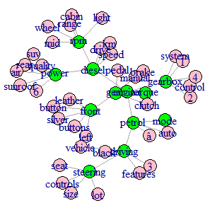
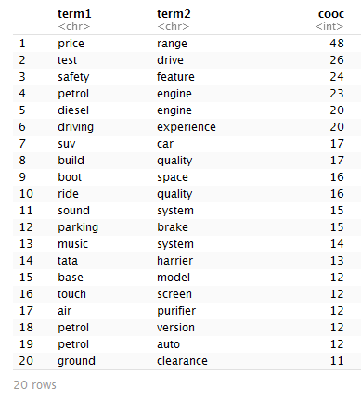
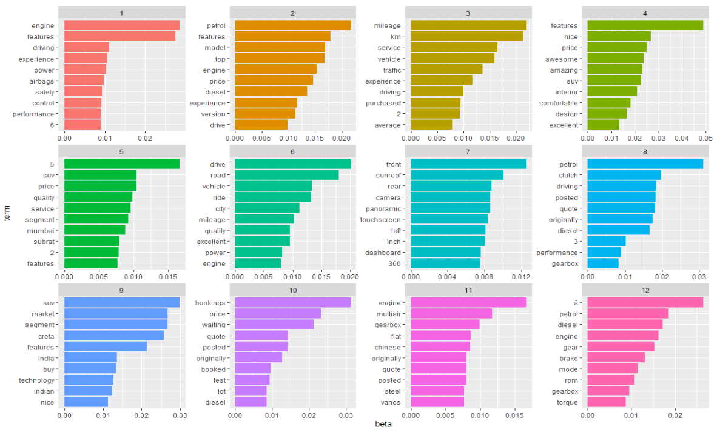
Customers are interested in features such as Price, Safety, Engine Performance, Driving Experience, Build Quality, Boot Space, Sound System, Interiors/Exteriors, Ground Clearance & Design
Co-occurrence Graphs (COGs)
Noun/Noun Phrases (UDpipe)
Latent Dirichlet allocation (LDA) algorithm
Feature List
Ground Clearance
Price Range
Design
Petrol Engine
Diesel Engine
Sound
Clutch
Service
Interior
Driving Experience
Sunroof
Mileage
Build Quality
Safety
Boot Space
Gearbox
Seats
Ride Quality
Air Purifier
Power

Slide 7
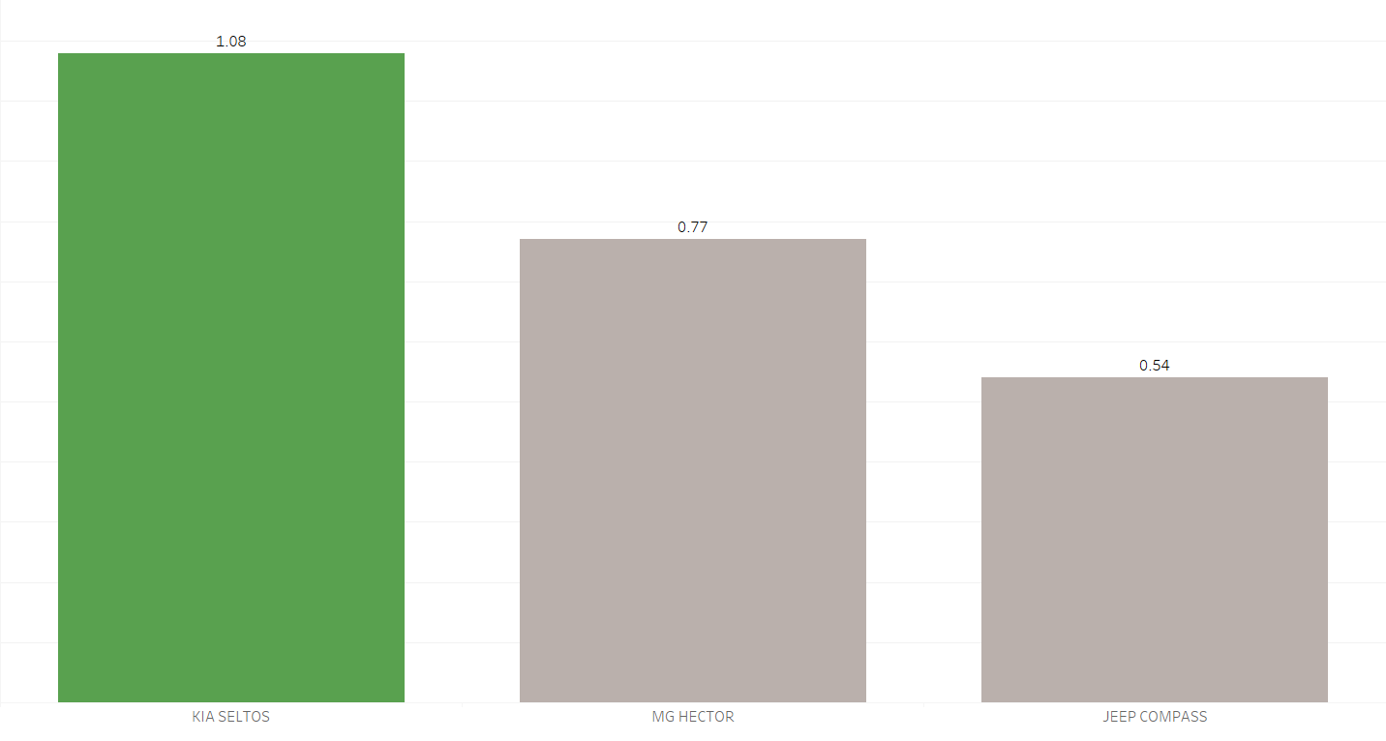
Overall there is highest positive sentiment for Kia Seltos followed by MG Hector & Jeep Compass
Overall Sentiment Score
Calculation Method
BING, AFINN, NRC, QDAP has a weightage of 1 each However Valence Shifter has a weightage of 2
Calculate weighted average for overall score and feature wise score

Slide 8
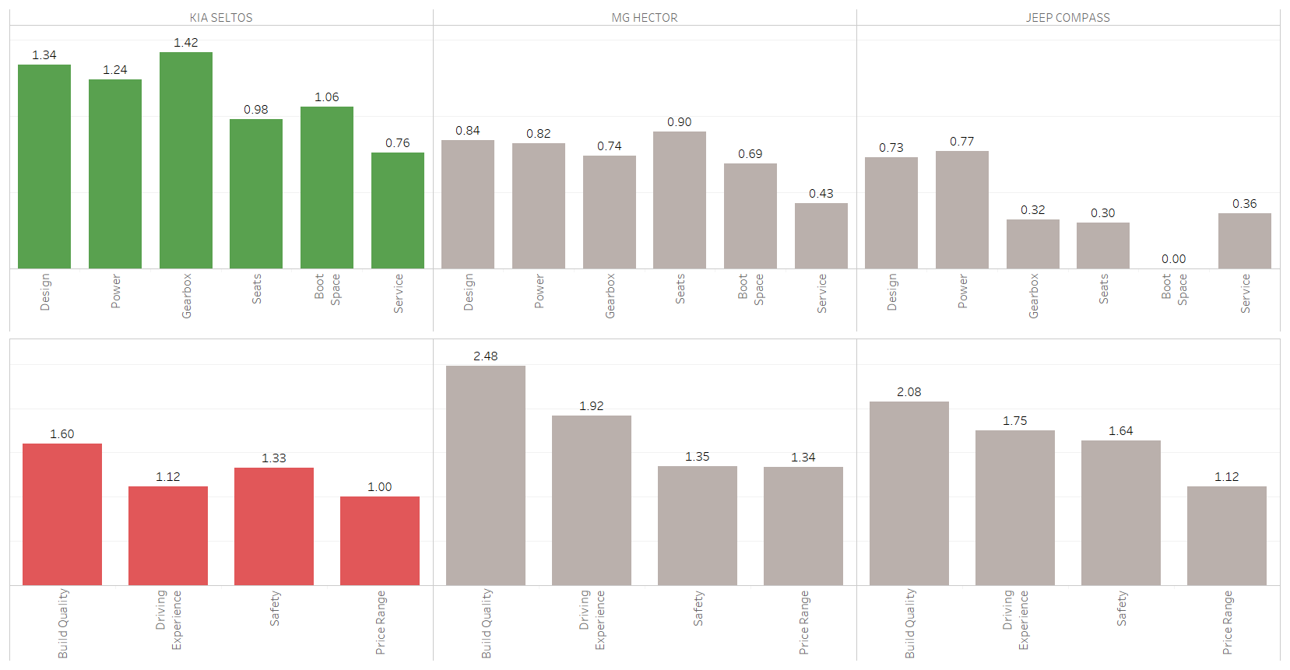
Design, Powerful Engine, Gearbox Options, Comfortable Seats, Large Boot Space & Availability of Service Centers are clear strengths of Kia Seltos whereas Build Quality , Driving Experience, Safety & Price Range are improvement areas for Kia Seltos
Revolutionary Design
Powerful Engine
Multiple Gearbox Option
Comfortable Seats
Large Boot Space
Availability of Service centers across major cities
are clear strengths of Kia Seltos to be leveraged by marketing & sales team in their promotional activities
Build Quality
Driving Experience
Safety Features
Pricing
are clear improvement areas to be considered by Kia product team in their upcoming SUV models

Slide 9
THANK YOU

